Slide 1
Group 3: System Unit and Its Components
By:
1. Che Ku Mardiah Binti Che Ku Mahhadi (SX241899ECJHF01)
2. Nicholas, SX240634ECRHS01
3. Arul,
4. Louis

Slide 2
System unit
Often referred to as the computer case or chassis
Is the main enclosure that houses the essential components of a computer
Serves as the framework for the internal hardware
Providing protection, organization
Connectivity for the various components that make up a computer system
Typically includes the motherboard, CPU, RAM, power supply, storage devices, and expansion cards
Definition of
System Unit

Slide 3
Major Internal Components
Motherboard
CPU (Central Processing Unit)
RAM (Random Access Memory)
Power Supply Unit (PSU)
Storage Devices
Expansion Cards

Slide 4
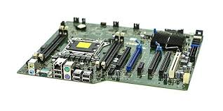
Motherboard
The main circuit board that connects all components of the computer.
It houses the CPU, RAM, and provides connectors for other peripherals and expansion cards.

Slide 5
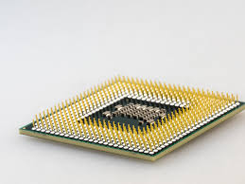
CPU (Central Processing Unit)
Often referred to as the brain of the computer, the CPU performs calculations and executes instructions from programs.

Slide 6
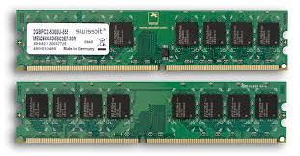
RAM (Random Access Memory)
A type of volatile memory that temporarily stores data and instructions that the CPU needs while performing tasks.
It allows for quick read and write access.

Slide 7
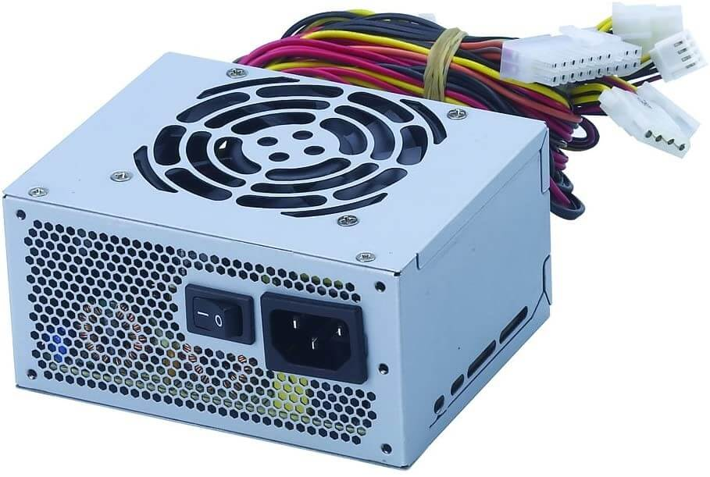
Power Supply Unit (PSU)
Converts electrical power from an outlet into usable power for the internal components of the computer.
It supplies power to the motherboard, CPU, and other peripherals.

Slide 8
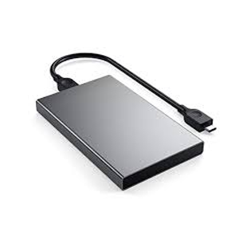
Storage Devices
These include Hard Disk Drives (HDDs), Solid State Drives (SSDs), and optical drives, which store data and programs permanently or semi-permanently.

Slide 9
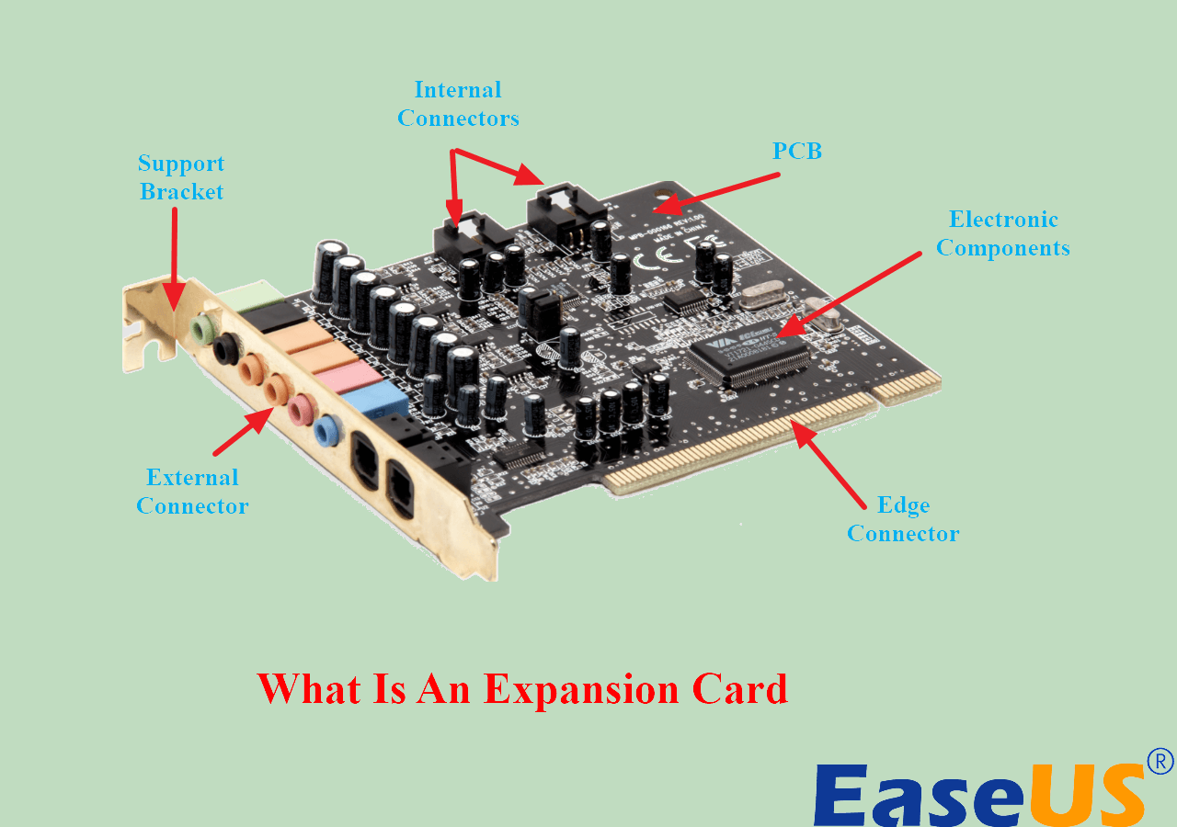
Expansion Cards
Additional cards that can be inserted into the motherboard to add functionality, such as graphics cards, sound cards, and network cards.

Slide 10
CPU is composed of several key components
Control Unit (CU)
Arithmetic Logic Unit (ALU)
Registers

Slide 11
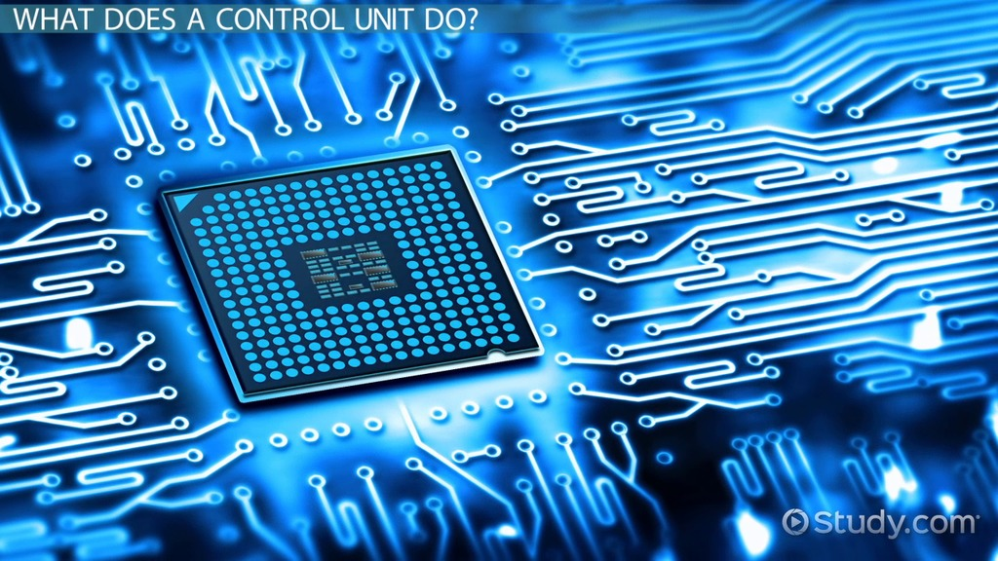
Control Unit (CU)
The part of the CPU that directs the operation of the processor.
It tells the computer's memory, ALU, and input/output devices how to respond to the instructions that have been sent to the processor.

Slide 12
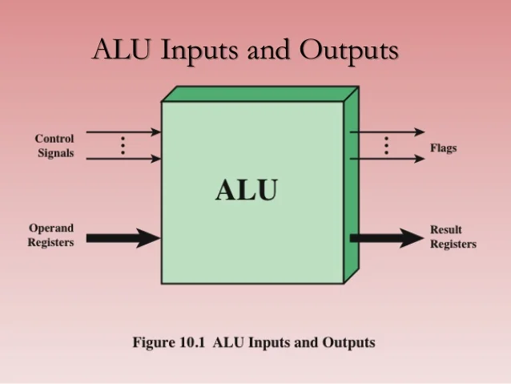
Arithmetic Logic Unit (ALU)
The component of the CPU that performs arithmetic and logical operations.
It handles all mathematical calculations and logical comparisons.

Slide 13
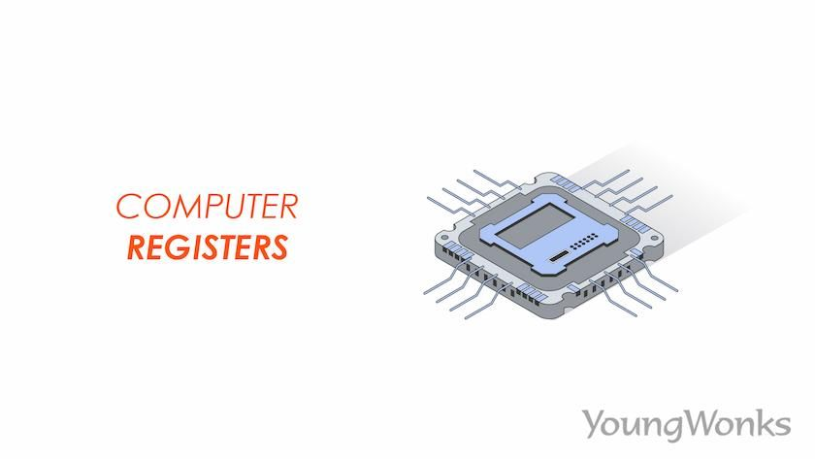
Registers
Small, high-speed storage locations within the CPU that temporarily hold data and instructions.
Registers are used to store intermediate results of calculations and to hold the addresses of memory locations.

Slide 14
Functions and Importance of Each Component

Slide 15
Motherboard
CPU
Acts as the backbone of the computer, allowing communication between all components.
It is crucial for system stability and performance.
Executes instructions and processes data, making it the most critical component for overall system performance.
A faster CPU can significantly enhance computing speed.

Slide 16
RAM
Power Supply
Provides temporary storage for data that the CPU needs to access quickly.
More RAM allows for better multitasking and smoother performance in applications.
Ensures that all components receive the correct voltage and current.
A reliable power supply is essential for system stability and longevity.

Slide 17
Storage Device
Expansion Cards
Store the operating system, applications, and user data.
The speed and capacity of storage devices affect system boot time and application load times.
Enhance the functionality of the computer, allowing for customization based on user needs, such as improved graphics or sound capabilities.

Slide 18
Visual Breakdown or Diagram of a System Unit
1.Outer Case:
A rectangular box that houses all components.
2. Motherboard: Positioned vertically or horizontally inside the case, with various slots for RAM, CPU, and expansion cards.
3. CPU: Located on the motherboard, often covered by a heatsink and fan.
4. RAM:
Placed in slots adjacent to the CPU on the motherboard.
5. Power Supply: Mounted at the top or bottom of the case, with cables running to the motherboard and other components.
6. Storage Devices: Located in designated bays, either mounted horizontally or vertically.
7. Expansion Cards:
Inserted into PCIe slots on the motherboard, protruding from the back of the case.

Slide 19
Quiz Time!!!
List three internal components of system unit.
What is the role of the control unit in the CPU?
Answer:
Motherboard, CPU, RAM
The part of the CPU that directs the operation of the processor. It tells the computer's memory, ALU, and input/output devices how to respond to the instructions that have been sent to the processor.

